Slide 1
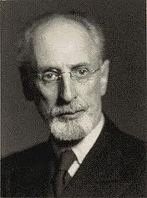
HO Model – Factor Proportions
Eli F. Heckscher, 1879-1952
Bertil Ohlin 1899-1979
Heckscher, a Swedish economist, and his student, Bertil Ohlin, sought an alternative explanation of source of comparative advantage. Heckscher also authored historical studies of economic policies that failed because the systems eschewed free trade: Mercantilism and Napoleon’s Continental System, which was economic warfare against the British.

Slide 2
Learning Objectives
Examine the need to build a new model
Understand its assumptions
Memorize and understand these theorems
Heckscher-Ohlin Theorem
Stolper-Samuelson Theorem
Factor-Price Equalization Theorem
Rybczynski Theorem

Slide 3
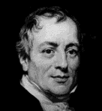
Ricardian Model
Strengths
Trade is mutually beneficial
High & low wage countries may trade
Explains some of the trade patterns we observe
David Ricardo
April 18, 1772 — September 11, 1823
Weaknesses
Why does so much trade occur among developed countries?
Why does technology differ across countries?

Slide 4
Ricardian Theorem
A country exports those goods for which its relative productivity exceeds its relative wage. It will import goods for which its relative wage exceeds its relative productivity.
Page 48, Ravendra N. Batra, Studies in the Pure Theory of International Trade

Slide 5
Specific-Factors Theorem
In the short run, when each industry has a specific factor and only labor is mobile, a rise in the relative price of a good will increase the relative price of the factor specific to the production of that good.
A move from autarky to free international trade benefits the owners of resources specific to export industries and harms the owners of resources specific to the import-competing industries. Labor may be better or worse off.

Slide 6
Heckscher-Ohlin (HO) Model
Built upon observed differences among
Resources that countries possess
Resources required to produce various goods
Insights
Causes of trade
Effects of trade on resource prices
Effect of economic growth on trade patterns
Political behavior

Slide 7
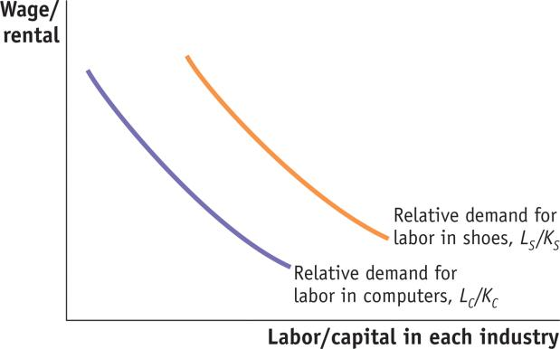
1 Heckscher-Ohlin Model
Assumptions of the Heckscher-Ohlin Model
Assumption 1: Two factors of production, labor and capital, can move freely between the industries.
Assumption 2: Shoe production is labor-intensive; that is, it requires more labor per unit of capital to produce shoes than computers.
FIGURE 4-1
Labor Intensity of Each Industry
Shoe production being more labor-intensive than computers implies:
L_{S}/K_{S} > L_{C}/K_{C}.
These two curves slope down just like regular demand curves, but in this case, they are relative demand curves for labor.
Notes:
7

Slide 8
1 Heckscher-Ohlin Model
Assumptions of the Heckscher-Ohlin Model
Assumption 3: Foreign is labor-abundant, by which we mean that the labor–capital ratio in Foreign exceeds that in Home, L*/K*> L/K. Equivalently, Home is capital-abundant, so that K/L >K*/L*.
Assumption 4: The final outputs, shoes and computers, can be traded freely (i.e., without any restrictions) between nations, but labor and capital do not move between countries.
Assumption 5: The technologies used to produce the two goods are identical across the countries.
Assumption 6: Consumer tastes are the same across countries, and preferences for computers and shoes do not vary with a country’s level of income.

Slide 9
Quantity definition of factor abundance
Country A is relatively capital abundant, if the ratio of its capital stock to its labor force (K/L) is greater than that of the other country:

Slide 10
Capital Intensity: Compare Capital (K) per Worker (L) for Selected US Industries
Thousands of 1972 dollars. P. 89, 8th edition, Husted & Melvin, International Economics
Notes:
Note:
The great variation across industries
K/L ratio has risen over time as K stock has grown faster than L force.
Ranking by industry little changed

Slide 11
Capital Abundance: Compare Capital per Worker: Selected Countries
1985 international prices. Item 4.2, page 91, 6th edition Husted & Melvin

Slide 12
Price definition of factor abundance
Country A is relatively capital abundant, if its wage-rental ratio (W/R) is higher than the other country’s wage-rental ratio:

Slide 13
Strong factor abundance assumption
If country A is relatively capital abundant, by the quantity definition, its wage-rental ratio (W/R) will be higher than the other country’s wage-rental ratio.
That is, the price definition holds, too.

Slide 14
Heckscher-Ohlin Theorem
A country will export the goods whose production is intensive in the factor with which that country is abundantly endowed.
Notes:
“Countries tend to export goods whose production is intensive in factors with which they are abundantly endowed.” page 76 Krugman & Obstfeld
A country will have comparative advantage in, and therefore will export, that good whose production is intensive in the factor with which that country is relatively well endowed.
Page 94, (5th edition) Husted & Melvin

Slide 15
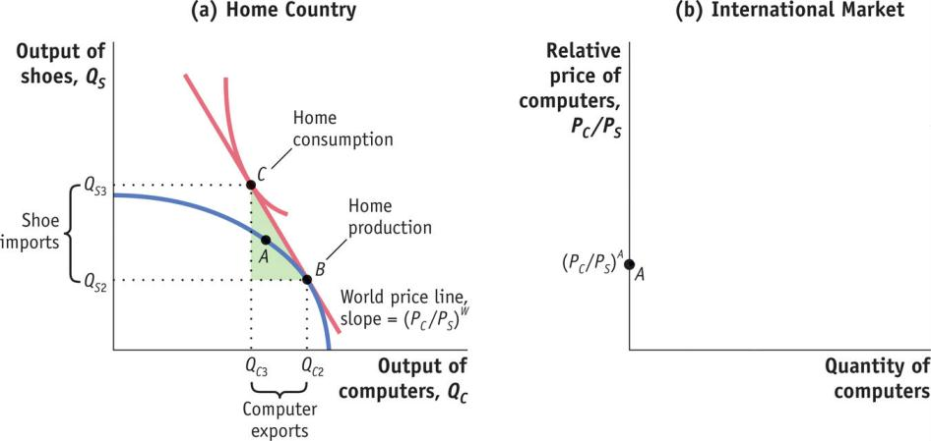
1 Heckscher-Ohlin Model
Free-Trade Equilibrium
Home Equilibrium with Free Trade
FIGURE 4-3 (1 of 2)
International Free-Trade Equilibrium at Home
At the free-trade world relative price of computers, (P_{C} /P_{S})^{W}, Home produces at point B in panel (a) and consumes at point C, exporting computers and importing shoes. Point A is the no-trade equilibrium.
The “trade triangle” has a base equal to the Home exports of computers (the difference between the amount produced and the amount consumed with trade, (Q_{C2} − Q_{C3}).

Slide 16
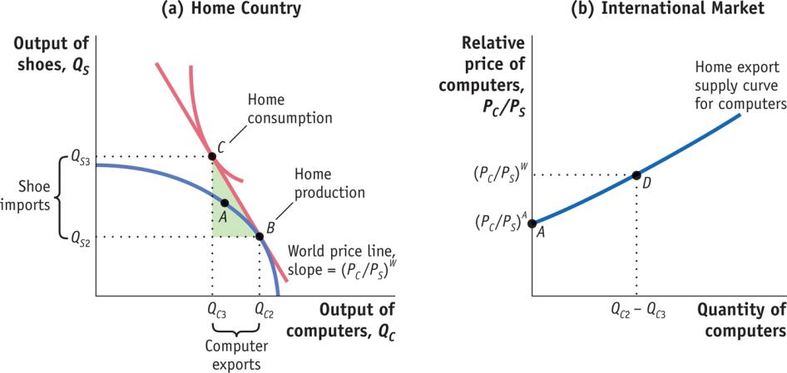
1 Heckscher-Ohlin Model
Free-Trade Equilibrium
Home Equilibrium with Free Trade
FIGURE 4-3 (2 of 2)
International Free-Trade Equilibrium at Home (continued)
The height of this triangle is the Home imports of shoes (the difference between the amount consumed of shoes and the amount produced with trade, Q_{S3} − Q_{S2}).
In panel (b), we show Home exports of computers equal to zero at the no-trade relative price, (P_{C} /P_{S})^{A}, and equal to (Q_{C2} − Q_{C3}) at the free-trade relative price, (P_{C}/P_{S})^{W}.

Slide 17
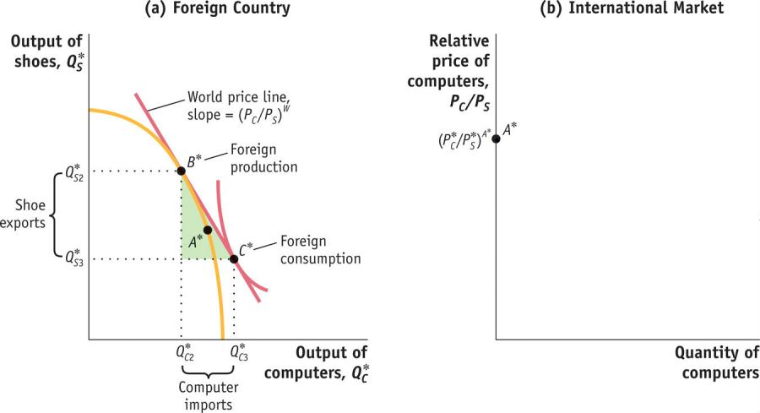
1 Heckscher-Ohlin Model
Free-Trade Equilibrium
Foreign Equilibrium with Free Trade
FIGURE 4-4 (1 of 2)
International Free-Trade Equilibrium in Foreign
At the free-trade world relative price of computers, (P_{C} /P_{S})^{W}, Foreign produces at point B* in panel (a) and consumes at point C*, importing computers and exporting shoes. Point A* is the no-trade equilibrium.
The “trade triangle” has a base equal to Foreign imports of computers (the difference between the consumption of computers and the amount produced with trade, Q*_{C3} − Q*_{C2}).

Slide 18
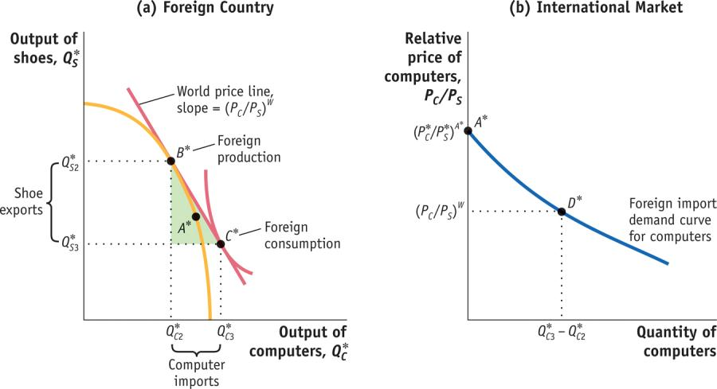
1 Heckscher-Ohlin Model
Free-Trade Equilibrium
Foreign Equilibrium with Free Trade
FIGURE 4-4 (2 of 2)
International Free-Trade Equilibrium in Foreign (continued)
The height of this triangle is Foreign exports of shoes (the difference between the production of shoes and the amount consumed with trade, Q*_{S2} – Q*_{S3}).
In panel (b), we show Foreign imports of computers equal to zero at the no-trade relative price, (P*_{C} /P*_{S})^{A}*, and equal to (Q*_{C3} − Q*_{C2}) at the free-trade relative price, (P_{C} /P_{S})^{W}.

Slide 19
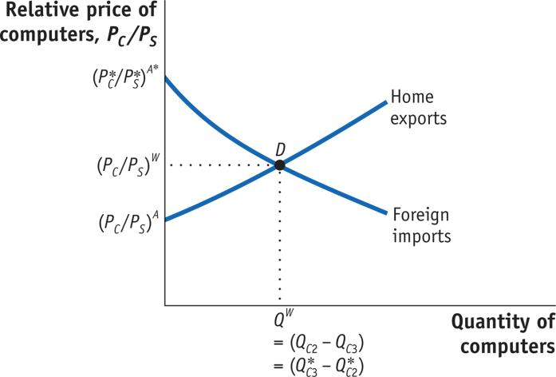
1 Heckscher-Ohlin Model
Free-Trade Equilibrium
Equilibrium Price with Free Trade
Because exports equal imports, there is no reason for the relative price to change and so this is a free-trade equilibrium.
FIGURE 4-5
Determination of the Free-Trade World Equilibrium Price
The world relative price of computers in the free-trade equilibrium is determined at the intersection of the Home export supply and Foreign import demand, at point D.
At this relative price, the quantity of computers that Home wants to export, (Q_{C2} − Q_{C3}), just equals the quantity of computers that Foreign wants to import, (Q*_{C3} − Q*_{C2}).

Slide 20
Stolper-Samuelson Theorem
An increase in the relative price of a commodity results in a rise in the real reward of its intensive factor and a decline in the real reward of its non-intensive factor.
Thus, a move from autarky to free international trade benefits the owners of a country’s abundant resources and harms the owners of its scarce resources.
Notes:
“Owners of a country’s abundant resources gain from trade, but owners of a country’s scarce resources lose.” page 77, Krugman & Obstfeld.
Free international trade benefits the abundant resource and harms the scarce resource.
Page 105, Husted & Melvin

Slide 21
Factor-Price Equalization (FPE) Theorem
Given all the assumptions of the HO model, free trade will lead to the international equalization of individual factor prices.
Let’s examine the publisher’s slides 33-37.
Home is capital abundant, Foreign is labor abundant
Shoes are labor intensive; computers are capital intensive
One relative price for computers, P_{C}/P_{S}
One wage-rental ratio, w/r

Slide 22
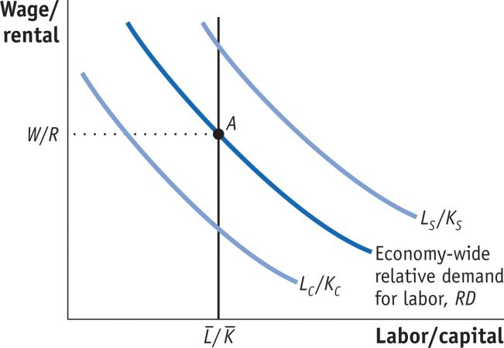
3 Effects of Trade on Factor Prices
Effect of Trade on the Wage and Rental of Home
Economy-Wide Relative Demand for Labor
FIGURE 4-10
Determination of Home Wage/Rental
The economy-wide relative demand for labor, RD, is an average of the L_{C} /K_{C} and L_{S} /K_{S} curves and lies between these curves.
The relative supply, L/K, is shown by a vertical line because the total amount of resources in Home is fixed.
The equilibrium point A, at which relative demand RD intersects relative supply L/K, determines the wage relative to the rental, W/R.
Relative supply
Relative demand

Slide 23
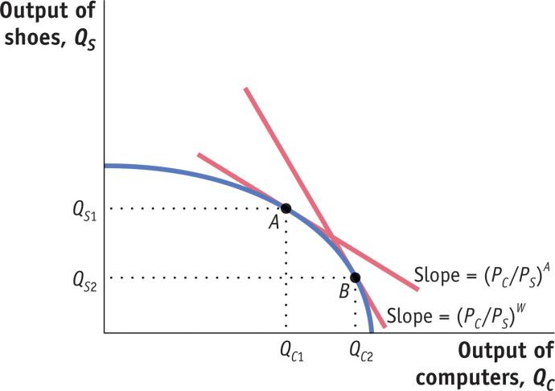
3 Effects of Trade on Factor Prices
Effect of Trade on the Wage and Rental of Home
Increase in the Relative Price of Computers
FIGURE 4-11
Increase in the Price of Computers
Initially, Home is at a no-trade equilibrium at point A with a relative price of computers of (P_{C} /P_{S})^{A}.
An increase in the relative price of computers to the world price, as illustrated by the steeper world price line, (P_{C} /P_{S})^{W}, shifts production from point A to B.
At point B, there is a higher output of computers and a lower output of shoes, Q_{C2} > Q_{C1} and Q_{S2} < Q_{S1}.

Slide 24
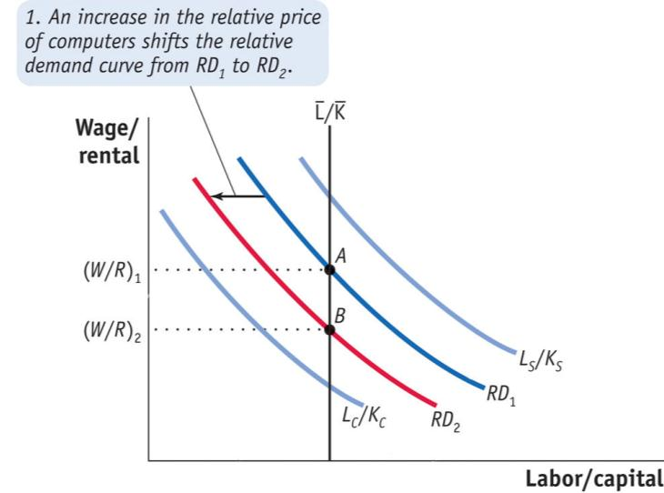
3 Effects of Trade on Factor Prices
Effect of Trade on the Wage and Rental of Home
Increase in the Relative Price of Computers
FIGURE 4-12 (1 of 2)
Effect of a Higher Relative Price of Computers on Wage/Rental
An increase in the relative price of computers shifts the economy-wide relative demand for labor, RD₁, toward the relative demand for labor in the computer industry, L_{C} /K_{C}. The new relative demand curve, RD₂, intersects the relative supply curve for labor at a lower relative wage, (W/R)₂.

Slide 25
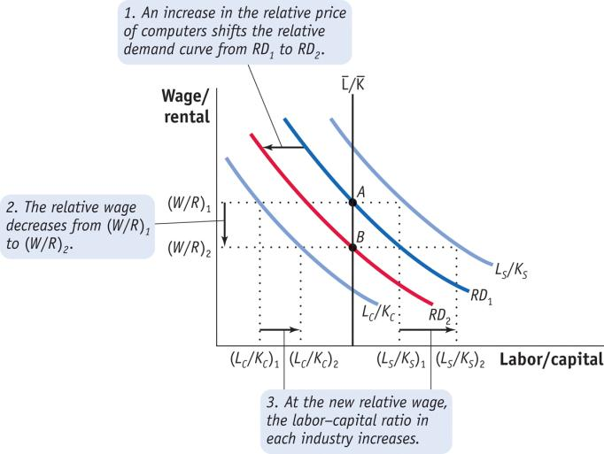
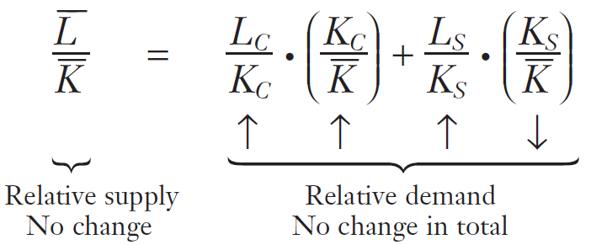
3 Effects of Trade on Factor Prices
Effect of Trade on the Wage and Rental of Home
Increase in the Relative Price of Computers
FIGURE 4-12 (2 of 2)
Effect of a Higher Relative Price of Computers on Wage/Rental
As a result, the wage relative to the rental falls from (W/R)₁ to (W/R)₂.
The lower relative wage causes both industries to increase their labor–capital ratios, as illustrated by the increase in both L_{C} /K_{C} and L_{S} /K_{S} at the new relative wage.

Slide 26
3 Effects of Trade on Factor Prices
Determination of the Real Wage and Real Rental
Change in the Real Rental
R = P_{C} • MPK_{C} and R = P_{S} • MPK_{S}
MPK_{C} = (R/P_{C})↑ and MPK_{S} = (R/P_{S})↑
This is an increase in the demand for capital. It would occur even with fixed factor propotions (L/K) in each industry. Also, as the L/K ratio increases in each industry, the MPK increases.
Change in the Real Wage
W = P_{C} • MPL_{C} and W = P_{S} • MPL_{S}
MPL_{C} = (W/P_{C} )↓ and MPL_{S} = (W/P_{S})↓
This is a decrease in the demand for labor. Also, as the K/L ratio decreases in each industry, the MPL decreases.

Slide 27
Factor-Price Equalization?
…has not happened. Why not?
Some goods are not produced in some countries.
Productivity (technology) does differ between countries.
Goods’ prices differ due to natural and artificial barriers to trade.
It (FPE) is limited to models with equal numbers of goods and resources. With n goods and n-1 resources it does not occur even in the model. Samuelson v. Ohlin…

Slide 28
Rybczynski Theorem
At constant world prices, if a country experiences an increase in the supply of one resource, it will produce more of the product intensive in that resource and less of the other.
Corollary: Factor-price insensitivity. When comparing the old and new long-run equilibria, there is no change in the W/R.
Notes:
See Figure 4.7, page 102 5th edition Husted & Melvin
Evidence: read item on “Dutch Disease, p. 292 5th ed.

Slide 29
Which is the K-intensive industry?
Labor used in ________________ production
L__
Increasing
O_
Capital used in ________ production
Increasing
__
1
Increasing
K_
K_
Capital used in _____ production
__
O_
L_
Labor used in ________________ production
Increasing

Slide 30
S is K intensive, T is L intensive
Labor used in Soybean production
L_{S}
Increasing
O_{S}
Increasing
T
Capital used in Textile production
1
Capital used in S production
K_{T}
K_{S}
Increasing
S
O_{T}
L_{T}
Labor used in Textile production
Increasing

Slide 31
Rybczynski Theorem
How do the outputs of the two goods change when the economy’s resources change?
Increase the amount of one factor, say K, and observe the results.
If world prices do not change (because the supply change is small), then W/R does not change. This ratio determines each industry’s choice of L/K, which in turn determine the real rental (MPK) and real wage (MPL). These do not change.
The capital-intensive industry must expand to absorb the additional capital, and it must hire some labor and still more capital from the contracting, labor-intensive industry.

Slide 32
K increases. S (K int.) expands. S needs more labor. T must contract
Increasing
L used in S production
L²_{S}
L¹_{S}
O²_{S}
O¹_{S}
Increasing
K used in S production
1
Increasing
K used in T production
T
K¹_{T}
K¹_{S}
K²_{T}
K²_{S}
2
S²
S¹
O_{T}
L used in T production
L²_{T}
L¹_{T}
Increasing

Slide 33
An increase in K in Country A.
Output of
T, Q_{T}
Slope = -P_{S}/P_{T}
Q¹_{T}
1
2
Slope = -P_{S}/P_{T}
Q²_{T}
PPF¹
PPF²
Q¹_{S}
Q²_{S}
Output of
S, Q_{S}

Slide 34
2 Testing the Heckscher-Ohlin Model
Leontief’s Paradox
TABLE 4-1
Leontief’s Test
Leontief used the numbers in this table to test the Heckscher-Ohlin theorem. Each column shows the amount of capital or labor needed to produce $1 million worth of exports from, or imports into, the United States in 1947. As shown in the last row, the capital–labor ratio for exports was less than the capital–labor ratio for imports, which is a paradoxical finding.

Slide 35
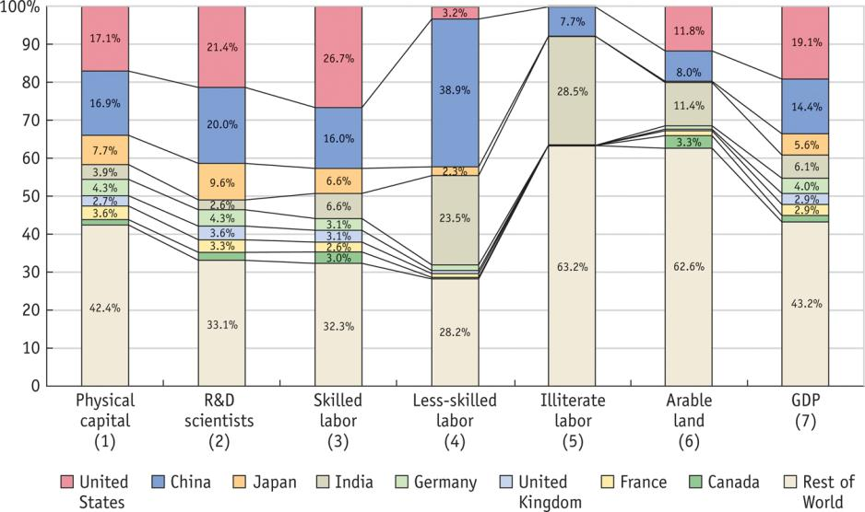
2 Testing the Heckscher-Ohlin Model
Factor Endowments in the New Millennium
Capital, Labor and Land Abundance
FIGURE 4-6
Country Factor Endowments, 2010
Shown here are country shares of six factors of production in the year 2010, for eight countries and the rest of the world. We see that 17% of the world’s physical capital was located in the United States, with 17% located in China, 8% located in Japan. In the final bar graph, we see the United States had 19% of world GDP, China had 14%, Japan had 5.6%, and so on.

Slide 36
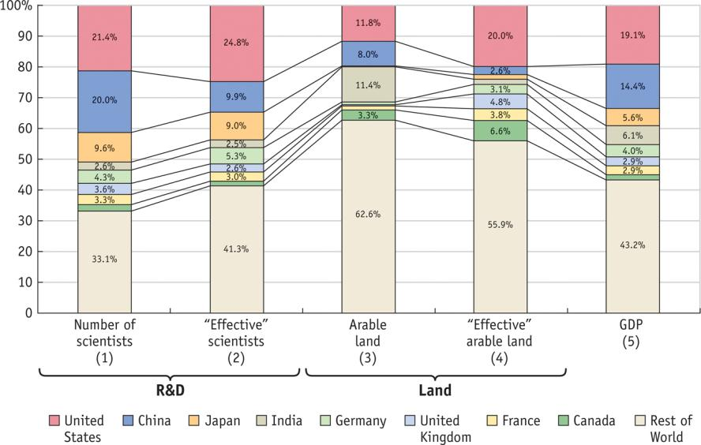
2 Testing the Heckscher-Ohlin Model
Differing Productivities Across Countries
FIGURE 4-7 (1 of 2)
“Effective” Factor Endowments, 2010
Shown here are country shares of R&D scientists and land in 2010, using the information from Figure 4.6, and adjusting for the productivity of each factor across countries to obtain the “effective” shares. China was abundant in R&D scientists (since it had 20% of the world’s R&D scientists as compared with 14% of the world’s GDP) but scarce in effective R&D scientists (having 7% of the world’s effective R&D scientists as compared with 11% of the world’s GDP).

Slide 37
2 Testing the Heckscher-Ohlin Model
Differing Productivities Across Countries
FIGURE 4-7 (2 of 2)
“Effective” Factor Endowments, 2010 (continued)
In 2010, the United States was scarce in arable land when using the number of acres (since it had 12% of the world’s land as compared with 19% of the world’s GDP) but neither scarce nor abundant in effective land (since it had 20% of the world’s effective land, which nearly equaled its share of the world’s GDP).

Slide 38
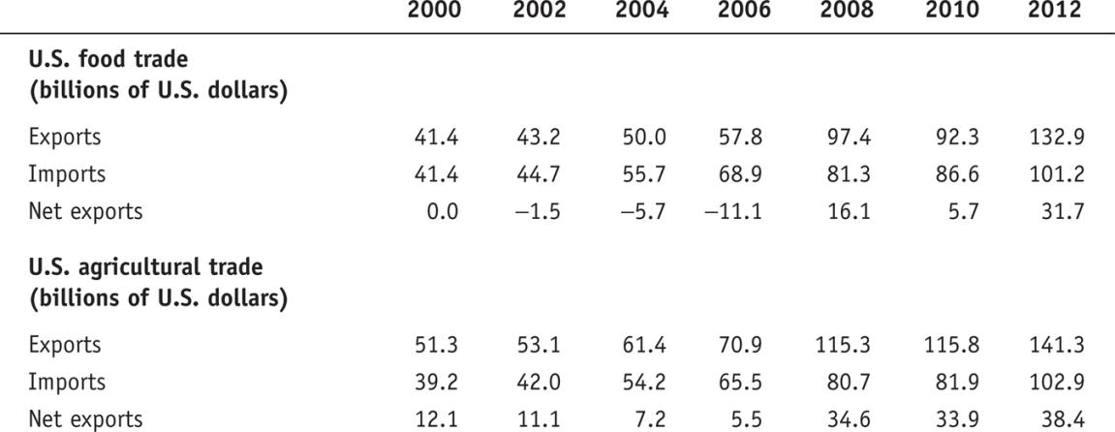
2 Testing the Heckscher-Ohlin Model
Differing Productivities Across Countries
Effective Arable Land
TABLE 4-2
U.S. Food Trade and Total Agricultural Trade, 2000–2012
This table shows that U.S. food trade has fluctuated between positive and negative net exports since 2000, which is consistent with our finding that the United States is neither abundant nor scarce in land. Total agricultural trade (including nonfood items like cotton) has positive net exports, however.

Slide 39
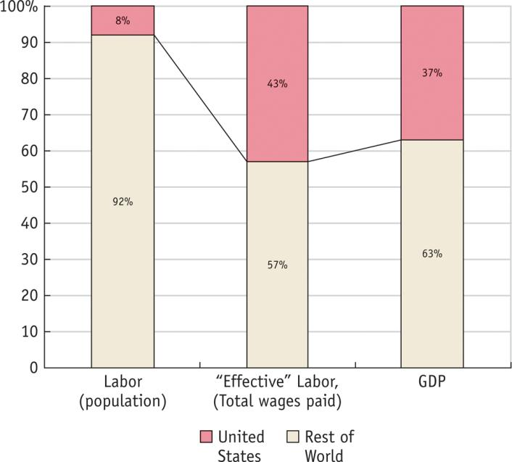
2 Testing the Heckscher-Ohlin Model
Leontief’s Paradox Once Again
Labor Abundance
FIGURE 4-8
Labor Endowment and GDP for the United States and Rest of World, 1947
Shown here are the share of labor, “effective” labor, and GDP of the U.S. and the rest of the world in 1947. The U.S. had only 8% of the world’s population, as compared to 37% of the world’s GDP, so it was very scarce in labor. But when we measure effective labor by the total wages paid in each country, then the United States had 43% of the world’s effective labor as compared to 37% of GDP, so it was abundant in effective labor.

Slide 40
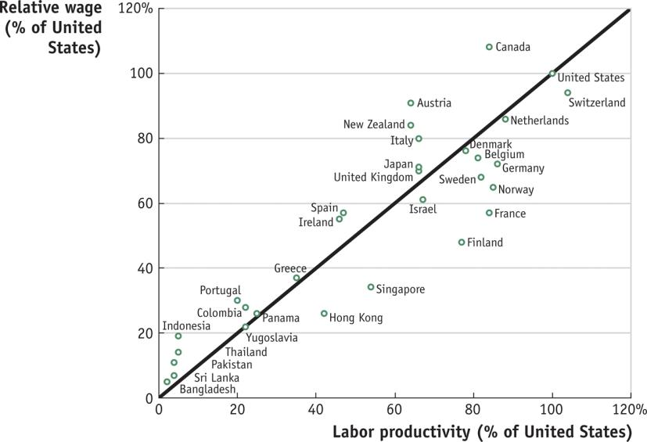
2 Testing the Heckscher-Ohlin Model
Leontief’s Paradox Once Again
Labor Productivity
FIGURE 4-9
Labor Productivity and Wages
Shown here are estimated labor productivities across countries, and their wages, relative to the United States in 1990.
Notice that the labor and wages were highly correlated across countries: the points roughly line up along the 45-degree line.
Notes:
We expect this close connection between wages and labor productivity from the Ricardian model, in which technology differences across countries determine wages, and this is also what we expect to hold in the Heckscher-Ohlin model once we drop the assumption of identical technologies.

Slide 41
Factor-price Insensitivity
This is a consequence of the Rybczynski Theorem. If growth does not change (relative) world prices, then it will not change the relative rewards to resources (W/R).
With constant W/R (and a given state of technology), the optimal L/K ratio in each industry will also be unchanged.
Notes:
See Figure 4.7, page 102 5th edition Husted & Melvin
Evidence: read item on “Dutch Disease, p. 292 5th ed.

Slide 42
Factor-price Equalization (FPE)
Q: Why does it occur in the model?
Capital will flow to the low-wage countries.
Labor will migrate to the high-wage countries.
None of the above, since the model assumes that resources are not allowed to cross borders.
Notes:
See Figure 4.7, page 102 5th edition Husted & Melvin
Evidence: read item on “Dutch Disease, p. 292 5th ed.

Slide 43
Factor-price Equalization (FPE)
Q: Why does it occur in the model?
A: The industry which uses the abundant resource intensively expands with trade, while the other industry contracts. This increases the relative demand for the abundant resource and decreases the relative demand for the scarce resource.
Notes:
See Figure 4.7, page 102 5th edition Husted & Melvin
Evidence: read item on “Dutch Disease, p. 292 5th ed.

